Slide 1
PREDICTING DELAYS ON ARRIVAL IN DOMESTIC FLIGHTS IN U.S.A
USING THE LOGISTIC REGRESSION (BINARY CLASSIFICATION) MACHINE LEARNING APPROACH

Slide 2
THE PROBLEM
Issues of delayed and or cancelled flights schedules has been a major problem in the aviation industry for long. Not only do air passengers have to bear with the disappointment of missing out on their favourite destination but also brings revenue loss to the airline companies and creates inconvenience at the said airports due to the strict scheduling of flights. The essence of this machine learning project is to train a machine to predict with high level of accuracy whether flight to a destination will be delayed or not given certain features.
The top 10 airlines companies, the top 7 destinations and Origin airport were used for the purpose of this project

Slide 3
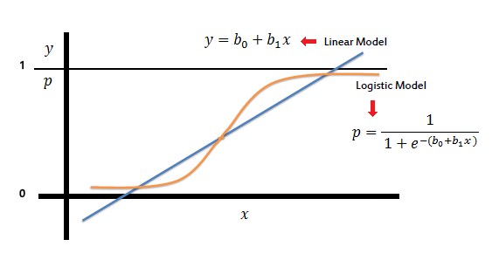
PROPOSED SOLUTION: LOGISTIC REGESSION

Slide 4
DATA SOURCE & PREPROCESSING
DECSRIPTION DATA
The dataset was retrieved from the United States Department of Transportation (Bureau of Transportation Statistics) and used solely for the purpose of this project. The data repository has information on all local flights within the USA. The data will be preprocessed and certain features reduced for the project.
Data Preprocessing
The essence of this phase is to present dataset in a format that can be learned and used to make predictions. Various preprocessing techniques were used on the data set to make it usable for the purpose of modeling the dataset. Data preprocessing techniques used included but not limited to feature selection and scaling from the original dataset, encoding categorical variables, taking out flights which were cancelled and looking out for null values

Slide 5
MODELLING
Machine Learning Python Libraries
- Sci-Kit learn - Pandas
- Seaborn - Numpy
** Splitting the data set and training the model
** Applying the trained model on the test set

Slide 6

MODEL PERFORMANCE MEASURES
Confusion Matrix
$$\left[\begin{matrix}4238 & 317 \\ 1118 & 1991\end{matrix}\right]$$
10-fold Cross Validation
Using the 10-folds cross validation metric yielded an 82% prediction accuracy
Precision,Recall, F-measure and Support
 | Precision | Recall | F1 score | support
0 | 0.79 | 0.93 | 0.86 | 4645
1 | 0.86 | 0.64 | 0.74 | 3109
Total/Avg | 0.81 | 0.81 | 0.81 | 7754

Slide 7
Conclusion and References
The predictive model was able to predict with an accuracy score of 81%
GITHUB Link for code:
https://github.com/hermannamoako/MLLRFlights/blob/master/MLLRFinalCode.py
REFERENCES:
https://www.datasciencecentral.com/profiles/blogs/predicting-flights-delay-using-supervised-learning
http://cs229.stanford.edu/proj2012/BandyopadhyayGuerrero-PredictingFlightDelays.pdf

